Slide 1
Image Processing and Computer Vision for Robots

Slide 2
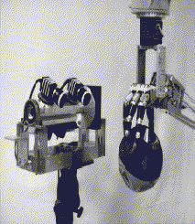

Slide 3
Convolution-based Image Processing, especially for texture partitioning and robot vision.

Slide 4
Convolution Application
in Robot Vision
First few examples what can be achieved with convolution
What is convolution
Different filters formed with Convolution
Convolution application examples

Slide 5
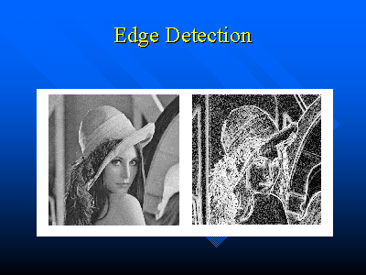

Slide 6
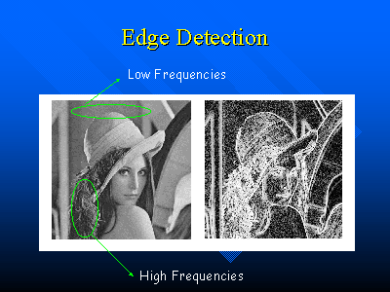

Slide 7
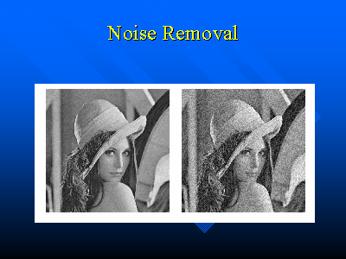

Slide 8
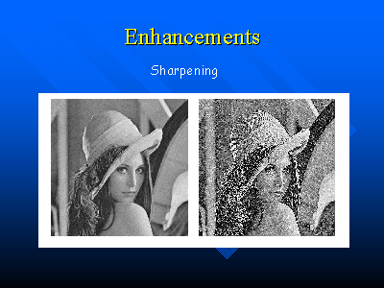

Slide 9


Slide 10
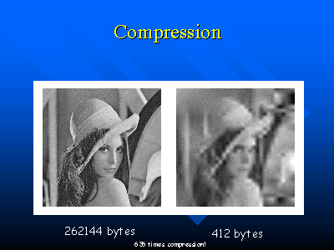

Slide 11
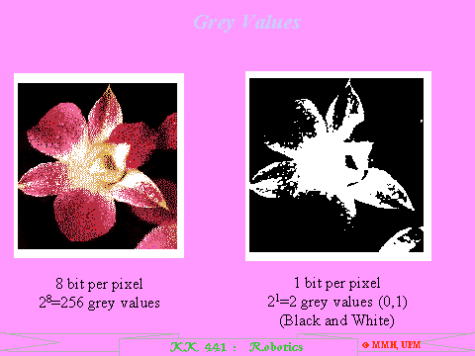
Binary Image Creation
Popularly used in industrial robotics

Slide 12
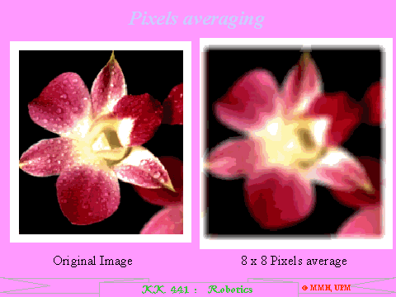
Pixels Averaging

Slide 13
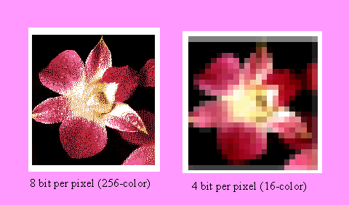
Bit per Pixel

Slide 14
Convolution Kernel
New Pixel Value Computed from Neighboring Pixel Values
Convolution of an N x N Matrix (Kernel) with the Image

Slide 15
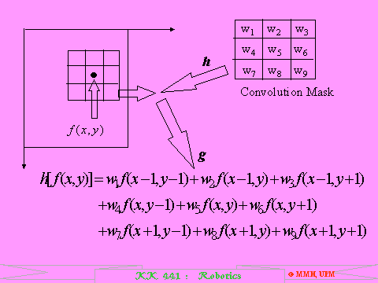
No division operation here
Convolution can be done serially, in parallel or in mixed way

Slide 16
Convolution kernel
W_{i} * F(f(x,y))
  Function of one variable F can be nonlinear, realized in a lookup table
F(f(x₁,y₁), f(x₂,y₂),…,f(x₉,y₉)) can be highly complicated and nonlinear function

Slide 17
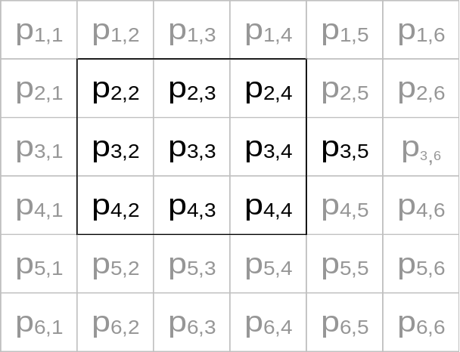
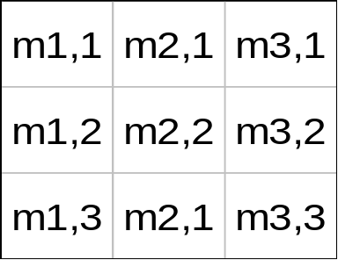
Example of a More general Convolution
p_{ij} is individual image elements in row i and column j
m _{i,j} is individual mask elements
Original Image
Mask

Slide 18
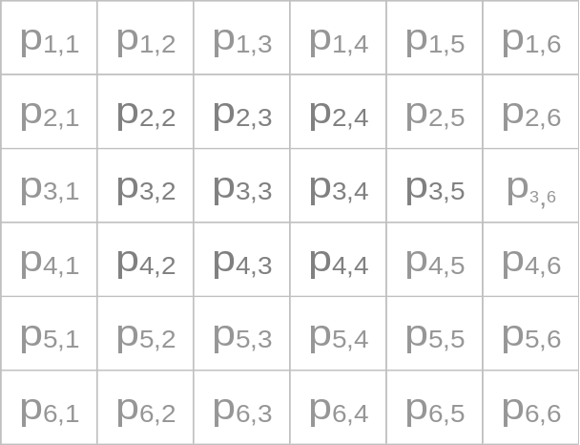
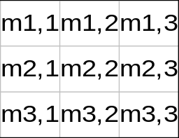

Animation of Convolution
To accomplish convolution of the whole image, we just
Slide the mask
Original Image
Mask
C_{4,2}
C_{4,3}
C_{4,4}
Image after convolution

Slide 19
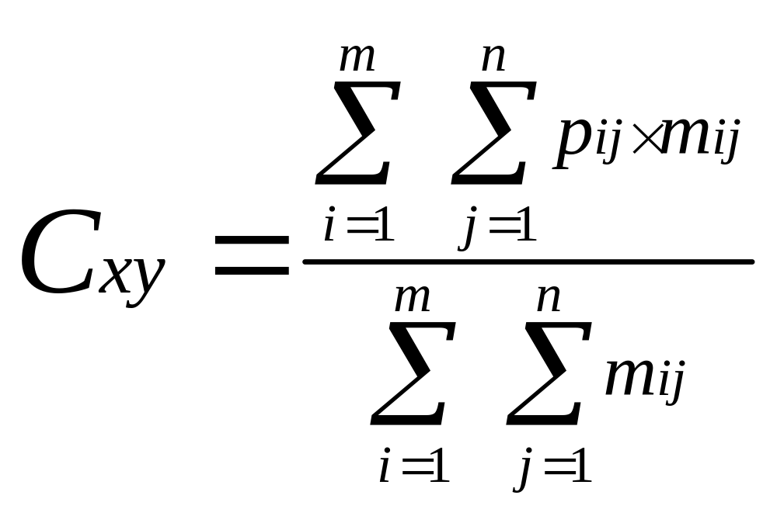
Example of a More general Convolution
More general Convolution (continued)
Requires division, too bad
At the heart of convolution operation is the convolution mask or kernel, shown as M(ask) or W(indow) in next figures
The quotient is known as the weight of the mask

Slide 20
Filtering by convolution
Algorithm
1. Reads the DN of each pixel in array
2. Multiplies DN by appropriate weight
3. Sums the products of (DN x weight) for the nine pixels, and divides sum by 9
4. Derived value applied to center cell of
array
5. Filter moves one pixel to right, and operation is repeated, pixel by pixel, line by line
No. 3

Slide 21
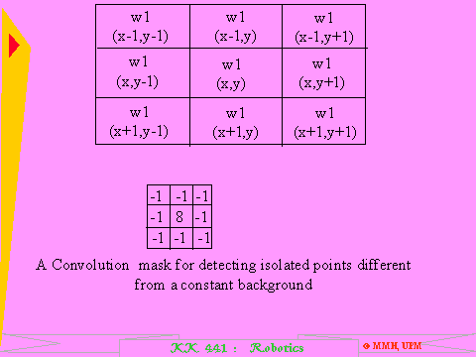
Detecting isolated points by convolution

Slide 22
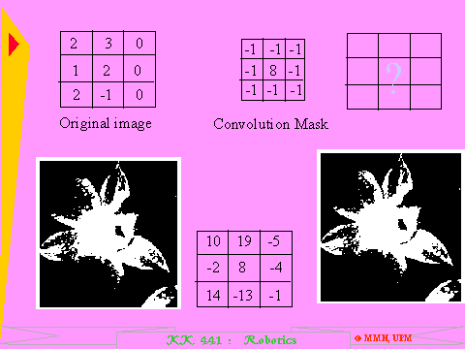
Detecting isolated points by convolution
Requires addition and multiplications, in general

Slide 23
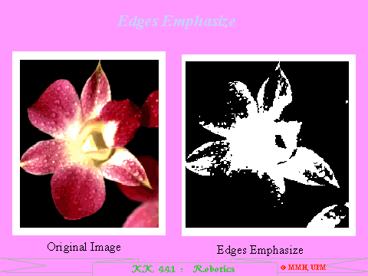
To find edges of objects
Turned to 2-level with edges emphasized

Slide 24
Image Frequencies and Filtering

Slide 25
Different Filters formed with Convolution
Different filters can be formed by applying convolution
With the former equation, we get linear filters, which each is a summation of weighted pixel intensities and then is divided by a constant value, or weight
Filters that modify their operation as the data elements change also be constructed which is defined as nonlinear filters, e.g. median filter.

Slide 26
Different Filters formed with Convolution
By the frequency-response characteristic, linear filter can be divided into
-- low-pass filter
-- high-pass filter
pass
pass
Response
Response
reject
reject
low
Frequency
high
low
Frequency
high
Filters (Masks) applied to zooming and noise elimination
are low pass filter
Filters (Mask) applied to edge detection or image sharpening are high-pass filter

Slide 27
Filtering Based on Convolution

Slide 28
Image Frequencies
Low Frequency Components = Slow Changes in Pixel Intensity
    regions of uniform intensity

Slide 29
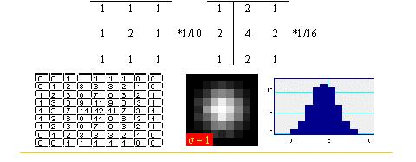
Low Pass Filter

Slide 30
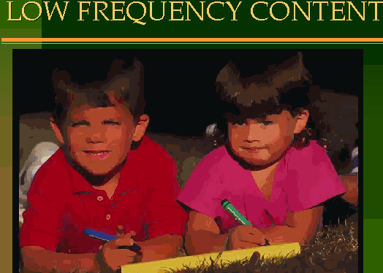
Low Frequency Content

Slide 31
High Frequency component of image and filtering
High Frequency Components = Rapid Changes in Pixel Intensity
regions with lots of details

Slide 32
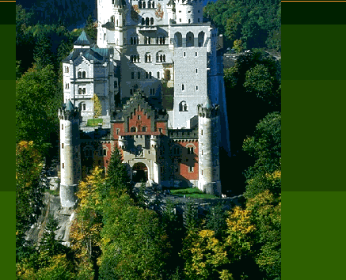
High Frequency Component

Slide 33
HIGH PASS FILTERS
Applied to digital data to remove slowly varying components, the low frequency changes in DNs from pixel to pixel, and to retain high frequency local variations
In general terms, fine detail and edges are emphasized - or enhanced - in the digital data

Slide 34
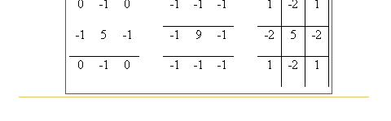
High Pass Filters

Slide 35
More About Kernels
Coefficients of the Kernel determine its function
Color Images: Operate on luminance only, or R/G/B?
Kernel Size
  smaller kernel = less computation
  larger kernel = higher quality results

Slide 36
How to handle Edge Pixels of the image?
How to deal with edges (no neighbors in some directions)?
Zero fill (black border around image),
or
duplicate edge pixels
or
don’t process the edges!

Slide 37
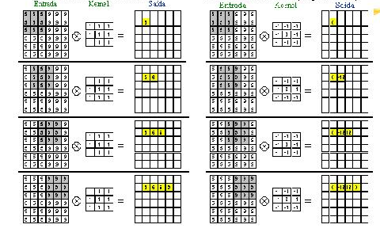
Basic Low Pass Filters and High Pass Laplacian Filter
image
result
image
result

Slide 38
Smoothing or Blurring
Low-Pass Filtering: Eliminate Details (High Frequencies)
Eliminates Pixelation Effects, Other Noise

Slide 39
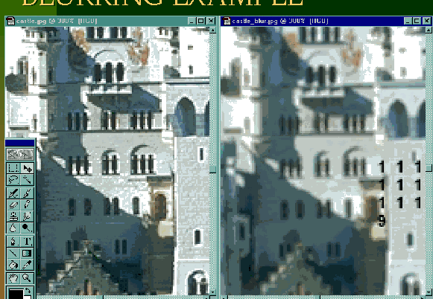
Blurring Example

Slide 40
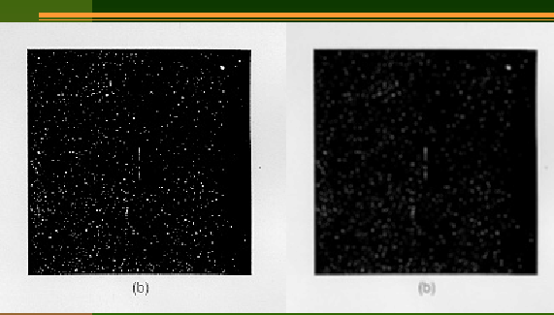
Blur of noise

Slide 41
Blurring continued
Sum of Kernel Coefficients = 1
  preserves average image density
Simple Averaging
Gaussian Blurring
  coefficients approximate the normal distribution

Slide 42
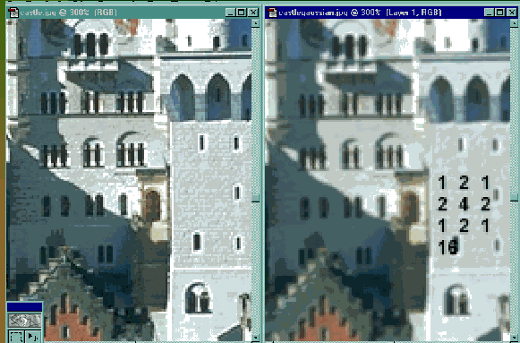
Gaussian Blur Example

Slide 43
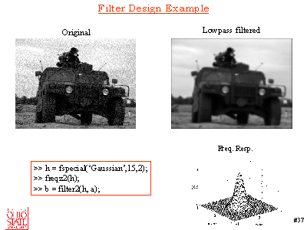
Filter Design Example in Mathlab

Slide 44
Zooming

Slide 45
Zooming as a Convolution Application Example
1 0 3 0 2 0
0 0 0 0 0 0
4 0 5 0 6 0
0 0 0 0 0 0
Convolve
1 1 1
1 1 1
1 1 1
1 3 2
4 5 6
Zero
interlace
Original Image
(1+0+3+0+0+0+4+0+5) ÷(1+1+1+1+1+1+1+1+1) = 13/9
The value of a pixel in the enlarged image is the average of the value of around pixels. The difference between insert 0 and original value of pixels is “smoothed” by convolution

Slide 46
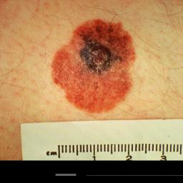
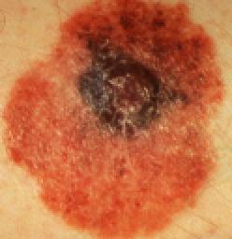
Zooming as a Convolution Application Example

Slide 47
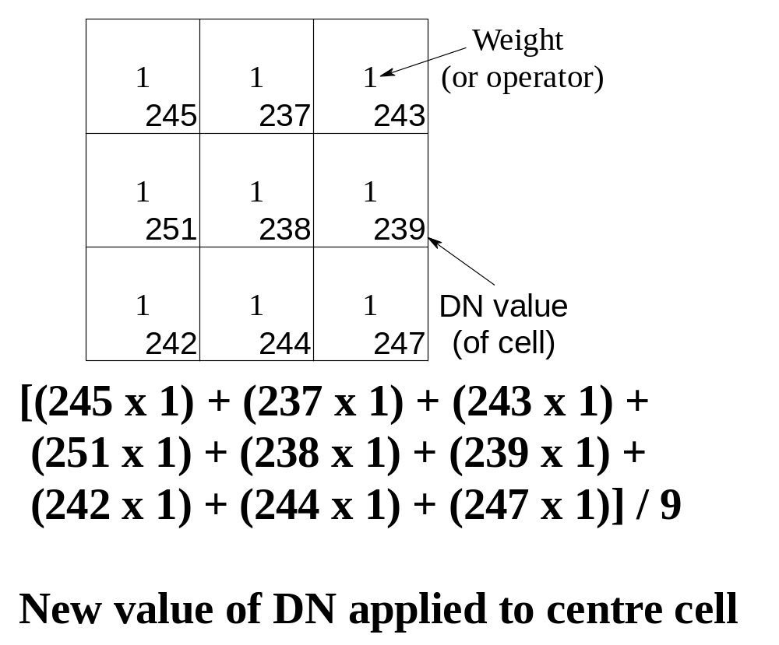
Low Pass Average Filter
Low Pass
(Average) Filter

Slide 48
IMAGE ENHANCEMENT BY LOW PASS FILTERS
Filter out medium and high frequencies and
’smooth' the image so that sharp edges or gradients, and random 'noise', are suppressed
Low frequency filter examines average brightness value of a number of pixels surrounding the pixel to be enhanced
Each pixel in the array is assigned a 'weight' or 'operator'

Slide 49
Median Filters and Noise Elimination

Slide 50
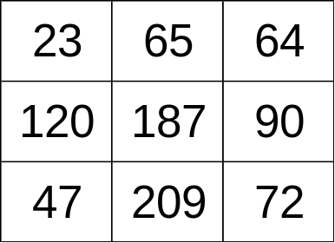
Noise Elimination as Convolution Application Examples
There are many masks used in Noise Elimination
Median Mask is a typical one
The principle of Median Mask is to mask some sub-image, use the median of the values of the sub-image as its value in new image
J=1 2 3
I=1
2
3
Rank: 23, 47, 64, 65, 72, 90, 120, 187, 209
median
Masked Original Image

Slide 51
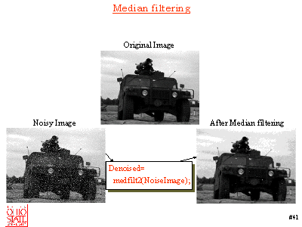
Median Filtering

Slide 52
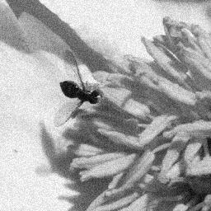
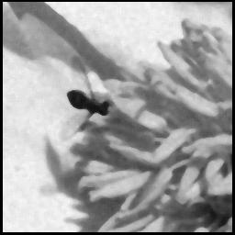
Noise Elimination as Convolution Application Examples
Convolution Application Examples
--Noise Elimination
The noise is eliminated but the operation causes loss of sharp edge definition.
In other words, the image becomes blurred

Slide 53
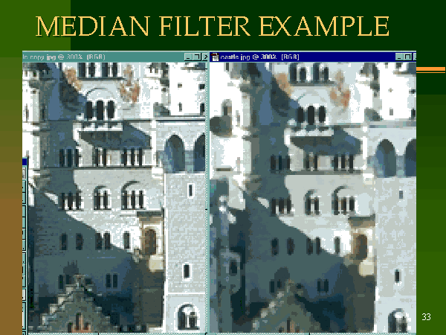
Median Filtering

Slide 54
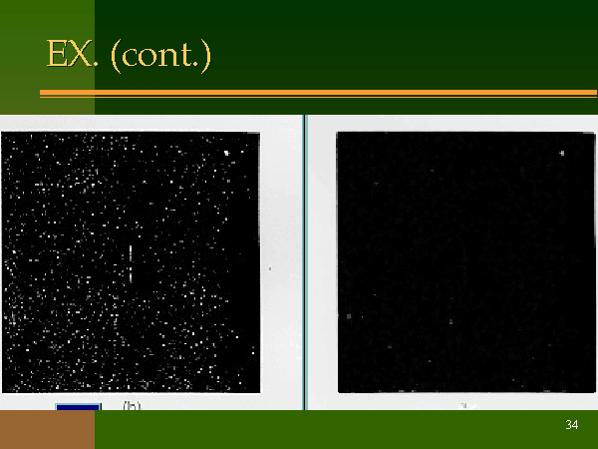
Median Filtering

Slide 55
Smart Approaches to Robot Vision

Slide 56
There are several good approaches to detect objects:
  Model-based vision.
1) We can have stored models of line-drawings of objects (from many possible angles, and at many different possible scales!), and then compare those with all possible combinations of edges in the image.
  Notice that this is a very computationally intensive and expensive process.
  This general approach, which has been studied extensively, is called model-based vision.

Slide 57
Motion vision.
2) We can take advantage of motion.
  If we look at an image at two consecutive time-steps, and we move the camera in between, each continuous solid objects (which obeys physical laws) will move as one, i.e., its brightness properties will be conserved.
  This gives us a hint for finding objects, by subtracting two images from each other.
  But notice that this also depends on knowing well:
    how we moved the camera relative to the scene (direction, distance),
    and that nothing was moving in the scene at the time.
  This general approach, which has also been studied extensively, is called motion vision.

Slide 58
Binocular stereopsis
3) We can use stereo (i.e., binocular stereopsis, two eyes/cameras/points of view).
  Just like with motion vision above, but without having to actually move,
  we get two images,
  we subtract them from each other,
  if we know what the disparity between them should be, (i.e., if we know how the two cameras are organized/positioned relative to each other), we can find the information like in motion vision.

Slide 59
Texture
4) We can use texture.
  Patches that have uniform texture are consistent, and have almost identical brightness, so we can assume they come from the same object.
  By extracting those we can get a hint about what parts may belong to the same object in the scene.
Shading and contours
5) We can also use shading and contours in a similar fashion.
  And there are many other methods, involving object shape and projective invariants, etc.

Slide 60
Biologically Motivated
Note that all of the above strategies are employed in biological vision.
It's hard to recognize unexpected objects or totally novel ones (because we don't have the models at all, or not at the ready).
Movement helps catch our attention.
Stereo, i.e., two eyes, is critical, and all carnivores use it
  unlike herbivores, carnivores have two eyes pointing in the same direction.
The brain does an excellent job of quickly extracting the information we need for the scene.

Slide 61
Clever Special Tricks that work:
Machine vision has the same task of doing real-time vision.
But this is, as we have seen, a very difficult task.
Often, an alternative to trying to do all of the steps above in order to do object recognition, it is possible to simplify the vision problem in various ways:
  1) Use color; look for specifically and uniquely colored objects, and recognize them that way (such as stop signs, for example)
  2) Use a small image plane; instead of a full 512 x 512 pixel array, we can reduce our view to much less.
    For example just a line (that's called a linear CCD).
    Of course there is much less information in the image, but if we are clever, and know what to expect, we can process what we see quickly and usefully.

Slide 62
Smart Tricks continued:
  3) Use other, simpler and faster, sensors, and combine those with vision.
    For example, IR cameras isolate people by body-temperature.
    Grippers allow us to touch and move objects, after which we can be sure they exist.
  4) Use information about the environment;
    if you know you will be driving on the road which has white lines, look specifically for those lines at the right places in the image.
    This is how first and still fastest road and highway robotic driving is done.

Slide 63
Vision as good sensor selection
Those and many other clever techniques have to be employed when we consider how important it is to "see" in real-time.
Consider highway driving as an important and growing application of robotics and AI.
  Everything is moving so quickly, that the system must perceive and act in time to react protectively and safely, as well as intelligently.
Now that you know how complex vision is, you can see why it was not used on the first robots, and it is still not used for all applications, and definitely not on simple robots.
A robot can be extremely useful without vision, but some tasks demand vision.
As always, it is critical to think about the proper match between the robot's sensors and the task.

Slide 64
Questions and Problems
1. Having talked about the type of sensors (external and proprioceptive), think about how they can be useful for general robotic tasks like navigation and manipulation.
2. Proprioceptive sensors sense the robot's actuators (e.g., shaft encoders, joint angle sensors, etc.); they sense the robot's own movements.
  You can think of them as perceiving internal state instead of external state.
3. External sensors are helpful but not necessary or as commonly used. Think of all.

Slide 65
Questions and Problems
4. Before we will learn about these areas in more detail, without any external influence, try to think how you would write software for the following:
  recognition of obstacles based on color,
  recognition of obstacles based on shape,
  recognition of moving targets based on motion,
  recognition based on three-dimensional model of obstacles.
5. Collect information on inexpensive computer cameras and analyze which of them is best for an eye of a robot head. Two such cameras are needed.

Slide 66
Questions and Problems
6. Write all applications of image processing and computer vision that you can think of
7. For some of them, that you are more familiar with, write what are the necessary stages of processing
8. Discuss convolution applications for color images.
9. How to remove high contrast details from an image
10. Apply your knowledge of filtering from circuit classes to images. How to design an image filter for a specific application

Slide 67
Questions and Problems
11. Write a Lisp program for zooming of a grey level image.
12. Write a Lisp program for a median filter
13. Design digital hardware of a pipelined median filter
14. Design a computer for convolution in which multiplying is done always by powers of two and implemented by shifting
15. Write Lisp program for noise elimination and experiment with different kernels

Slide 68
Sources
Bryan S. Morse
Many WWW sources
Anup Basu, Ph.D. Professor, Dept of Computing Sc. University of Alberta
Professor Kim, KAIST
Computer science, University of Massachusetts, Web Site: www-edlab.cs.umass/cs570
Maja Mataric
Dodds, Harvey Mudd College
Damien Blond
Alim Fazal
Tory Richard
Jim Gast
Bryan S. Morse
Gerald McGrath
Vanessa S. Blake
Many sources of slides from Internet
http://www.cheng.cam.ac.uk/seminars/imagepro/

Slide 69
Sources
533 Text book
http://sern.ucalgary.ca/courses/CPSC/533/W99/
presentations/L2_24A_Lee_Wang/
http://sern.ucalgary.ca/courses/CPSC/533/W99/
presentations/L1_24A_Kaasten_Steller_Hoang/main.htm
http://sern.ucalgary.ca/courses/CPSC/533/W99/
presentations/L1_24_Schebywolok/index.html
http://sern.ucalgary.ca/courses/CPSC/533/W99/
presentations/L2_24B_Doering_Grenier/
http://www.geocities.com/SoHo/Museum/3828/
optical.html
http://members.spree.com/funNgames/katbug/

